Slide 1
WELCOME MEETING
for international students
A.Y. 2024/25

Slide 2
WELCOME MEETINGS - BACHELOR’S DEGREE IN ANIMAL CARE
Programme:
30 SEPTEMBER 2024 - Classroom Filanda 1- Corte Benedettina
11.00-11.30 Welcoming International Students - International Desk
11.30-12 Presentation of the study path by the programme coordinator Prof. Laura Cavicchioli & OFA insights by Prof. Ballarin
Light refreshments with classmates and professors
1 OCTOBER - Classroom Filanda 2 - Corte Benedettina
11.00-11.15: Inclusion services
11.15-11.30: Library services
11.30: Learning tools (Moodle and Uniweb), offices and services with tutors
**The meetings will be also held online for students still abroad: https://unipd.zoom.us/meeting/register/tZUtc-6qrDsuGteAt0OsJg8venr8Jr_kmz1G
Notes:
Preferire un carattere sans serif come Arial, Helvetica o Verdana. Font consigliabile da 30 a 40 pt.
Allineare i testi a sinistra, non giustificarli.
Utilizzare non più di tre blocchi di informazione per diapositiva.
Per evidenziare titoli o parole chiave, prediligere l’uso del grassetto a corsivo o colori.
Evitare ombre, sfumature e gradazioni di grigio.
Prestare attenzione al contrasto tra sfondo e testo. Prediligere testo nero su sfondo bianco.

Slide 3


AGENDA:
ENROLMENT
RESIDENCE PERMIT
HEALTH CARE
TUITION FEES - BENEFITS
HOUSING
EDUCATIONAL OFFER
WELCOME ACTIVITIES AND STUDENTS SERVICES
DEPARTMENTAL OFFICES/SERVICES
LIVING THE CAMPUS & THE CITY
Notes:
‹#›
Elisabetta

Slide 4
ENROLMENT

Slide 5
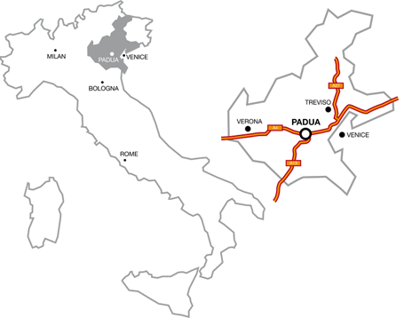
HOW TO GET TO PADUA
BY AIR : Venezia "Marco Polo" Airport (49 km). From the airport, travel to Padova by:
- BUSITALIA coaches;
- Train from Venezia–Mestre railway station. The airport is linked to the train station by ATVO Fly bus or ACTV city bus no. 15;
Venice-Treviso (A. Canova) Airport (52 km). From the airport, travel to Padova by:
- Bus (every 30 min): MOM 101 or BusItalia
- Train from Treviso Centrale railway station. The airport is linked to the train station by bus: airbus, bus 6, MOM 101, MOM 103.
Air Service, Goopti or Landomas minibus.
Book at least 24 hours in advance.
BY TRAIN: The railway station is a 15-minute walk from the city center; there are train services to Venice, Trieste, Verona, Milan, Bologna, Florence and Rome. For timetables and information:
-Trenitalia (high speed and local trains): phone: 92021 www.trenitalia.com
- Italo (high speed trains): phone: 060708 www.italotreno.it
BY COACH:
Flixbus Bus stop: via Fra’ Paolo Sarpi 42 (near the railway station), Padova;
BY CAR (toll motorways) :
www.autostrade.it
- A4 Torino – Trieste. Exits: Padova Ovest and Padova Est
- A13 Bologna – Padova. Exit: Padova Sud and Padova Zona Industriale
Notes:
‹#›
Elisabetta

Slide 6


ENROLMENT FINALISATION
If you have not done it yet, please do not forget to:
activate your provisional UNIPD credentials as soon as possible and no later than the 30th of September 2024;
provide us with your missing entry requirements (entry title and/or valid proof of language proficiency) by the deadline indicated in your online application task(s) and Admission Letter;
[only for non-EU students residing abroad] request your Study Visa and keep updated the relevant task in your online application.
The sooner you complete all these compulsory steps, the sooner your enrolment will be processed ONLINE by the Admissions and Welcome Unit, starting from the beginning of September.

Slide 7
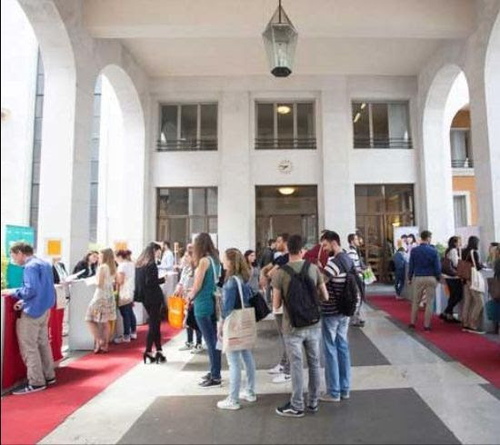
ENROLMENT FINALISATION
The Admissions & Welcome Unit is temporary located in
Riviera Tito Livio, n. 46 Padova
Upon your arrival in Padua, you must deliver in person the required enrolment documents by booking an appointment here (select the option "Welcome desk for degree seekers").
Please note that you are exempted from the in-person appointment if you have obtained:
your qualification in one of the countries listed in ARDI (Automatic Recognition Database – Italia) AND/OR
the CIMEA Statement of Verification.

Slide 8

FLASH CARD
What is it?
The Flash Card is the University student card which is issued from the bank partner of the University of Padua – Intesa San Paolo bank.
How do I receive it?
If on Uniweb you have indicated a foreign address, you will be notified via e-mail how to collect - by appointment - your Flash Card 1 month on after your enrolment finalisation.
Flash Up Studio
You can upgrade your Flash Card to a card with financial purposes at the Intesa Sanpaolo branch located in Corso Giuseppe Garibaldi, 22/26, Padova.
https://www.unipd.it/en/flash-card

Slide 9
RESIDENCE PERMIT

Slide 10
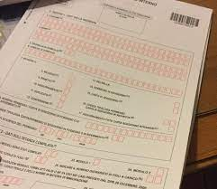
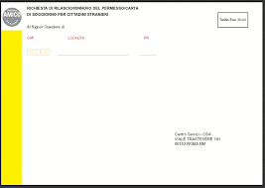
RESIDENCE PERMIT
Step by step guidelines
Videotutorial
You can register here to join the online webinars on how to fill in the Residence Permit request every Thursday at 12.00 pm until 10th October.
SAOS OFFICE
Immigration Support Service
www.unipd.it/en/saos
saos@unipd.it

Slide 11
RESIDENCE PERMIT
IMPORTANT! Please keep in mind that:
until you receive your Residence permit card, bring always with you your application receipt (ASSICURATA);
you can not miss your appointment to hand in your documents at the Questura (Police Headquarters);
You need to pass at least one exam during the first academic year to renew your residence permit for the second one.The residence permit must be renewed every year until the completion of your studies;
If you do NOT complete these requirements and you return to your home Country, it will not be possible to legally reside in Italy and continue your studies at UniPd;
If your residence permit expires while you are abroad and you have not renewed it yet, you will need a re-entry Visa.

Slide 12
HEALTHCARE

Slide 13
HEALTHCARE - EU
Students coming from EU countries can benefit from medical assistance in Italy thanks to the European Health Insurance Card (EHIC, in Italian “TEAM”) issued by the competent health institution in your country of residence.
The EHIC gives you access to the National Health Service for “urgently needed medical treatments” during temporary stay.
You can voluntarily register in the National Health Service. The voluntary registration entitles you to benefit the Italian healthcare services like Italian citizens do; it is valid for one calendar year (from 1st January to 31st December); the payment is not divisible and you cannot apply retroactively.
https://www.unipd.it/en/healthcare-EU

Slide 14
HEALTHCARE - NON EU
Non-European students must hold a valid medical insurance in order to apply for their residence permit.
The medical insurance can be obtained through :
private insurance
voluntary registration in the National Health Service
EHIC- only for students residing in a EU country
For further information please check:
https://www.unipd.it/en/healthcare-nonEU
And read the Guide to Health services released by the
Veneto Region, which is available online in multiple languages:
https://www.venetoimmigrazione.it/public/download/369_task33_guida_servizi_sanitari_english_vl.pdf

Slide 15
ULSS 6 DESK
To assist international students in registering to the NHS, the University of Padua and ULSS 6 have opened a dedicated office in Palazzo Bo.
International students can access healthcare services by registering to the National Health Service (NHS). Registration to the NHS is voluntary, valid for one calendar year (from 1 January to 31 December) and requires the payment of a registration fee.
ULSS 6 Desk
Palazzo Bo, via VIII Febbraio 2, 35122 Padova
email: uniulss@aulss6.veneto.it
Book an appointment with the ULSS 6 Desk

Slide 16
TUITION FEES - BENEFITS

Slide 17
TUITION FEES
The fee structure applied to students enrolled depends on their citizenship and country of residence:
https://www.unipd.it/en/tuition-fees
How and when to pay
The payment is made in three instalments.
The FIRST instalment is € 202 for first-year students of any degree programme.
You have already paid it once you have accepted the admission offer.
The SECOND and the THIRD instalments depend on your status (citizenship and country of residence) and degree programme.
The SECOND instalment must be paid by 15 February.
The THIRD instalment must be paid by 15 May.
Tuition fees can be paid through PagoPA, mode, available on Uniweb ("Contribuzione"). Detailed instructions on PagoPA are available on page www.unipd.it/en/pagopa

Slide 18
ISEE
ISEE (Equivalent Economic Status Index): https://www.unipd.it/en/isee
Application for ISEE Parificato
"ISEE Parificato" is an official certificate which indicates your financial standing in any given year on the basis of family status, earnings, property and expenses. The ISEE Parificato calculation service is free of charge and must be requested from the CAF that has an agreement with the University and ESU:
CAF CIA Padova: caf-iseeunipd@ciapadova.it
How to obtain the "ISEE Parificato"
For further information on how to obtain your ISEE and apply for the economic benefits, see the Guide. Documents must be uploaded to the portal of the CAF, available at the following link: unipd.cafciaisee.it
ISEE is required to access different services and opportunities (ie. application for ESU public Halls of residence, student part time job opportunities at the Univeristy, discuonted prices at the University canteens etc.)

Slide 19

PART-TIME JOB
As an international student in Italy, you are free to take a part-time job in order to help cover your costs.
Please note that Non-European students with a permit of stay for study reasons are allowed to work up to 20 hours/week.
You could therefore look for part-time job opportunities/student jobs in private companies/organizations.
During your 2nd year of studies, you can also apply for one of the part-time job opportunities offered by our University such as student collaborations (200 hours).
For further information:
https://www.unipd.it/en/studying-padova/funding-and-fees/part-time-job-opportunities

Slide 20
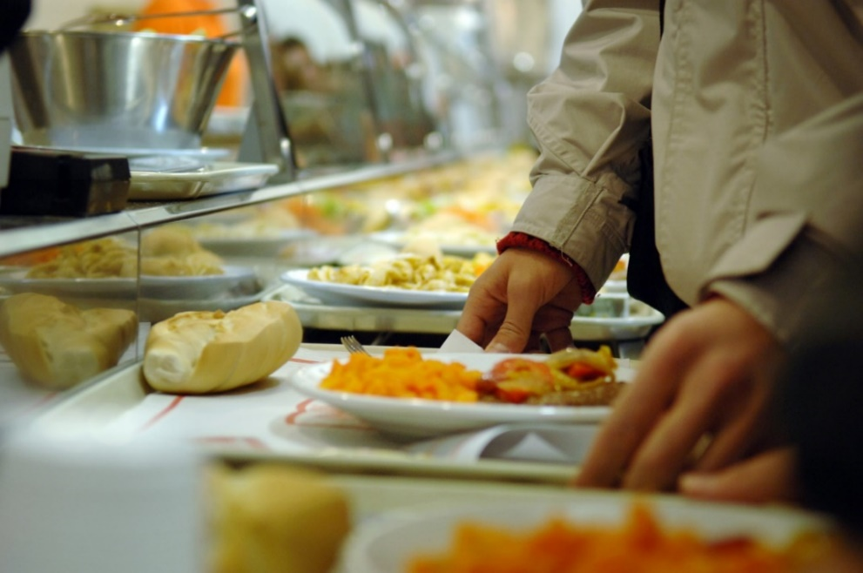
CANTEENS
All students can use the canteens managed by the ESU or other partners.
Canteens are located in the city centre or near the main University buildings (even in other cities).
The price of meals (lunch OR dinner) varies according to your financial situation (assessed by the ISEE).
Access to canteens is given through QRcode identification​, generated by the ESUPd.EAT app, which can be downloaded for free from the app stores.
For further information:
https://www.esu.pd.it/en/food-service/
Benefits and Contribution to Right to Study
Via S. Francesco, 122
dirittoallostudio@esu.pd.it

Slide 21
HOUSING

Slide 22

PRIVATE MARKET
HOUSING OFFICE
Dedicated to International Students seeking accommodation in Padua
Help in the house search in the private market (list of available properties on the website)
Orientation in the private accommodation market
Legal support & translation of the contracts and explanation of their content (declaration of hospitality, tenancy agreement, etc.)
Website: http://unibeds.it
Email: housing@unipd.it

Slide 23

PRIVATE MARKET
International housing platform for students, PhD candidates and trainees
Special benefits for UniPD students
Safely book your new accommodation, offered by verified private landlords and by outgoing students. Rooms offered by outgoing students can be easily recognized thanks to the "Verified Student" VIP badge on their profile.
Discount on booking fee & priority direct assistance
http://housinganywhere.com/

Slide 24
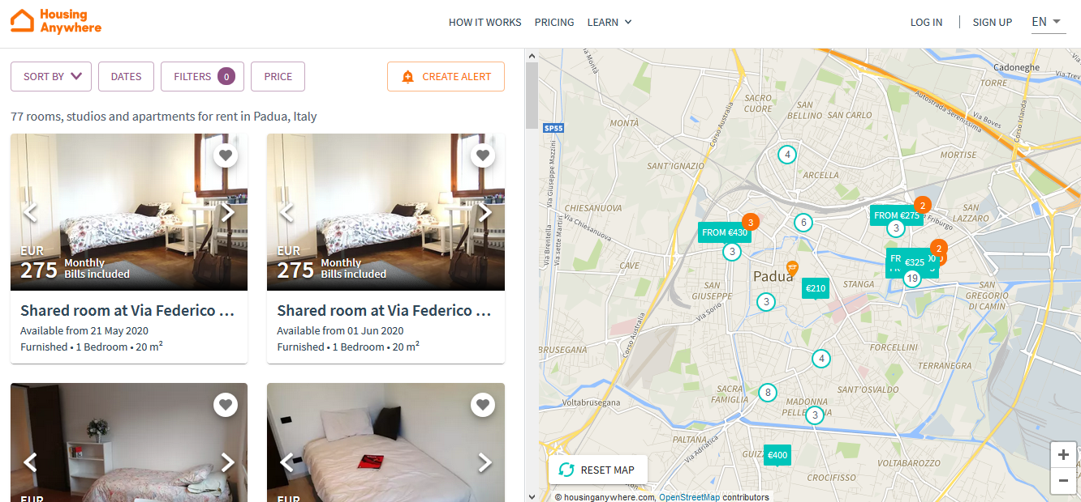
PRIVATE MARKET

Slide 25
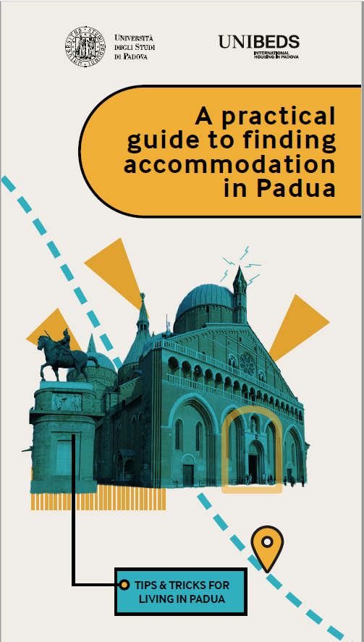
TIPS & TRICKS: THE HOUSING GUIDE
A brand-new tool to:
Learn all about Padua & its districts
Find out how to move around comfortably
Discover the housing market
Tips & tricks on how to look for an accommodation
Some legal precautions (contracts, registrations, etc)
How to avoid scams!
Average price for a single room:
€400-500/month

Slide 26
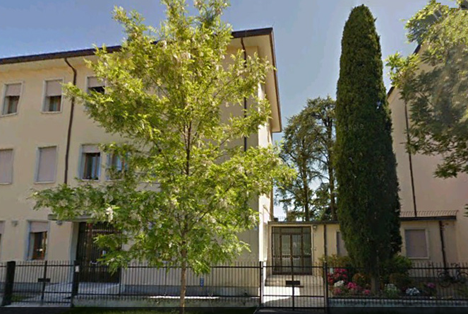
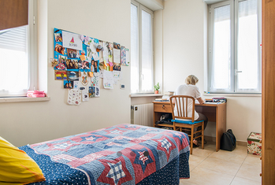
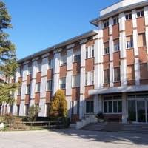
PRIVATE COLLEGES
PRIVATE COLLEGES
Each college applies different prices and conditions and includes different services (e.g. half/full board)
For information and bookings, contact directly the college you are interested in
Full list at: www.unipd.it/en/housing

Slide 27
EDUCATIONAL OFFER

Slide 28
LESSON TIMETABLES
The academic year starts on 1st October 2024 and lessons start on 30th September 2024 for most degree programmes
To verify the specific timetable of your classes please visit the student’s Web Agenda.
To find out where classes of your degree programme take place please visit the website of the relevant Department https://www.unipd.it/en/departments
First semester: Classes: 30 September 2024 to 18 January 2025
Winter exam session: 20 January 2025 to 22 February 2025
Second semester: Classes: 24 February 2025 to 14 June 2025
Summer exam session: 16 June 2025 to 19 July 2025
Extra exam session: 18 August 2025 to 20 September 2025

Slide 29

LIBRARIES AND STUDY ROOMS
Thanks to 29 libraries, the University offers an
extremely wide range of volumes, magazines,
e-books etc.
https://www.unipd.it/en/libraries
www.unipd.it/en/multimedia-facilities
In addition to the resources normally available in open access, the University of Padova also provides contents and tools usually accessible only under subscription. Most of the resources can be consulted off-campus using the Auth-Proxy service or the University Single Sign On authentication.
http://bibliotecadigitale.cab.unipd.it/en/digitalsolidarity/covid-19-open-or-free-access-online-resources
Notes:
‹#›
Elisabetta

Slide 30
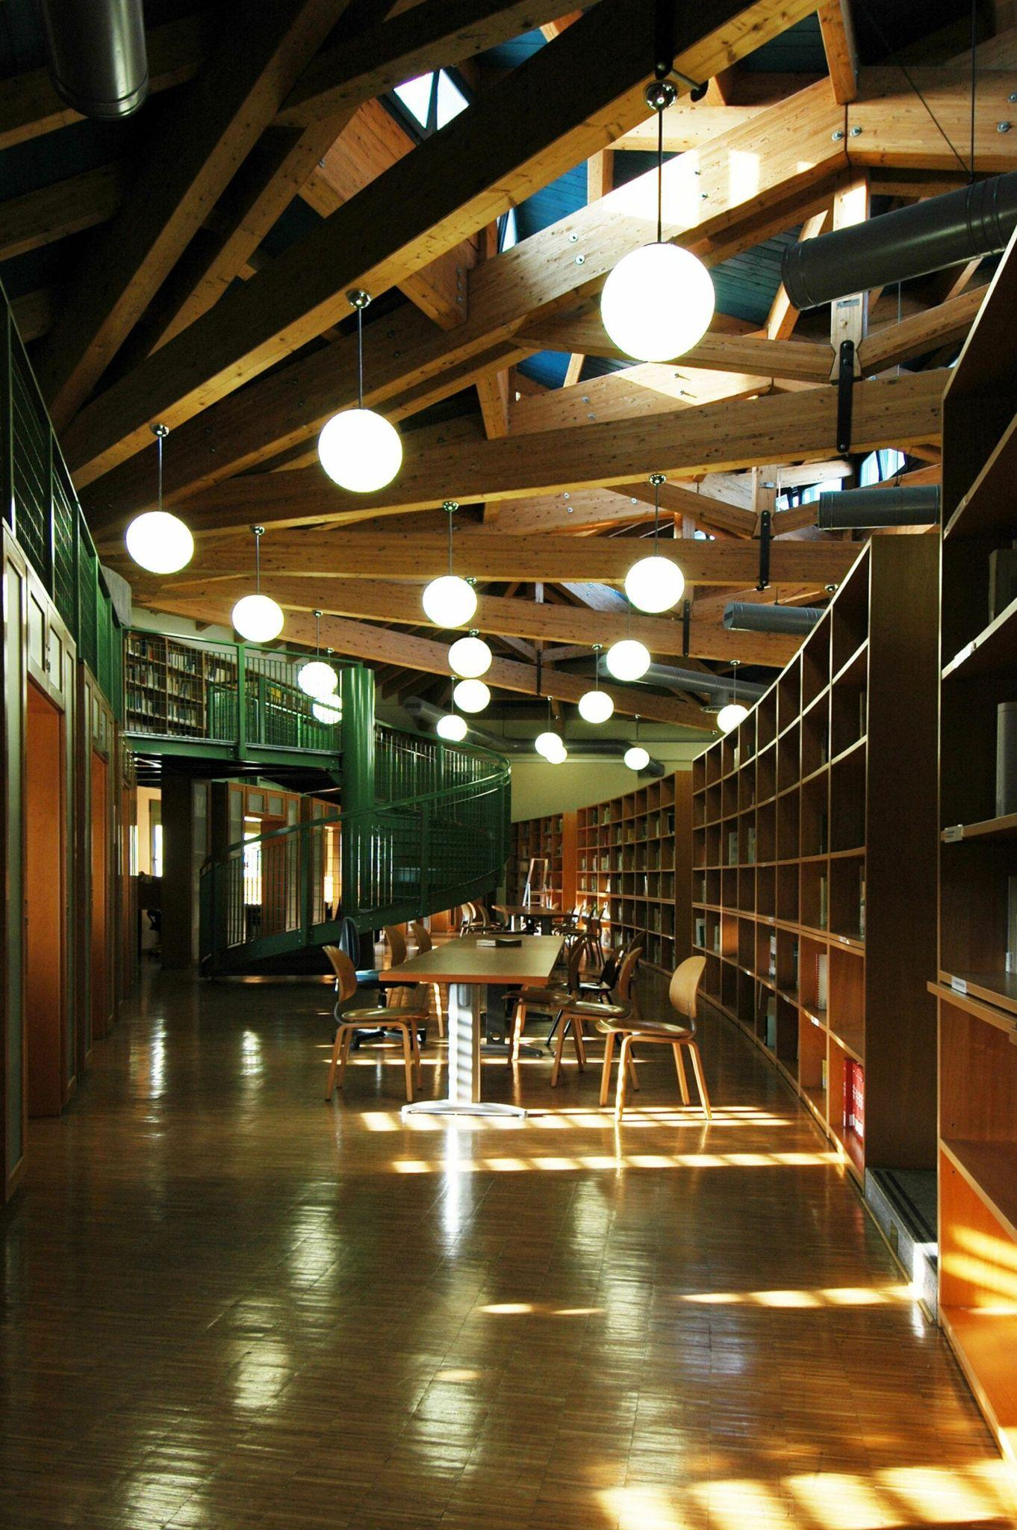
Library in Agripolis
Library "Pietro Arduino" of CIS Agripolis- Agripolis Campus - Pentagono building, 2nd floor
from Mondays to Thursdays 8.30 - 18.00
Friday 8.30 - 14.30 - book your place via Affluences
email
biblio.agripolis@unipd.it
Notes:
‹#›
Elisabetta

Slide 31
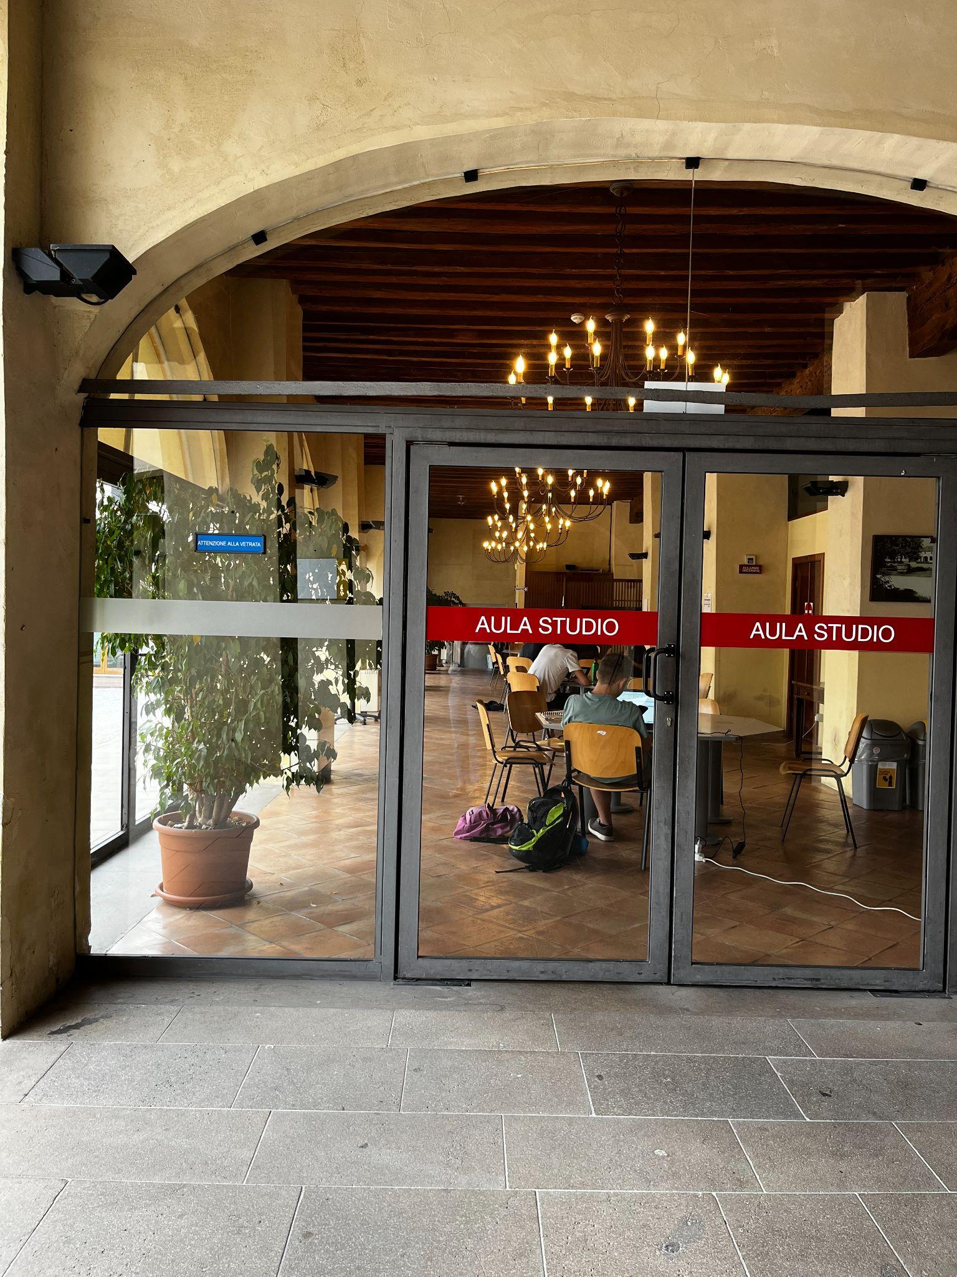
Study rooms in Agripolis
MUSEUM STUDY ROOM (32 places)
Agripolis (ground floor, Museum Building) - Map
STUDY ROOMS (Polo multifunzionale di Agripolis)- Map
Pentagono, firts east floor (24 seats)
Pentagono, first west floor (20 seats)
Penatgono, second east floor (20 seats)
Corte Benedettina, ground floor (20 seats)
Notes:
‹#›
Elisabetta

Slide 32
WELCOME ACTIVITIES
AND
STUDENT SERVICES

Slide 33

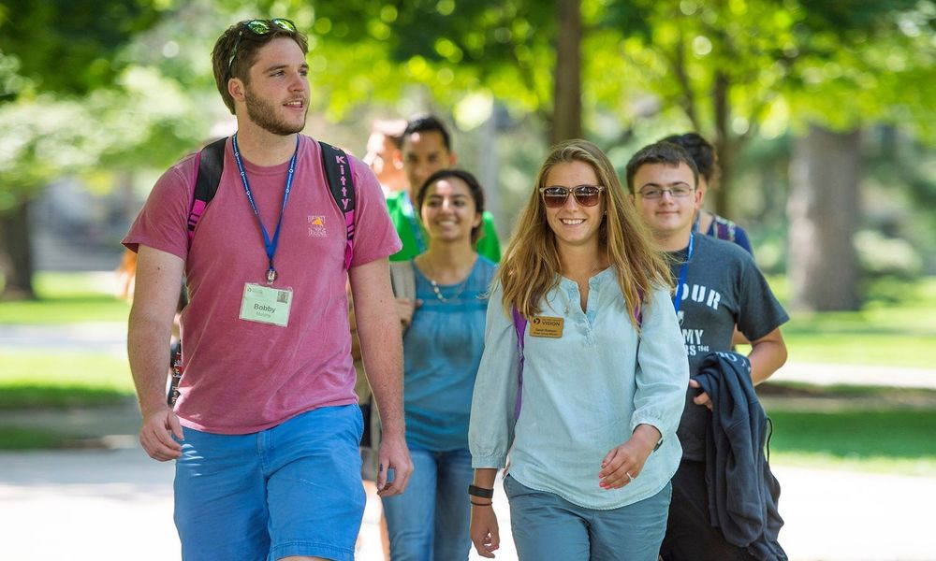
WELCOME ACTIVITIES
Tutor Buddy
A senior university student who welcome and support newly enrolled international students with arrival and registration procedures & help in integration into university life
Your buddy should have contacted you via e-mail! Fell free to get in touch with him/her!
Campus Tour
Explore the main university facilities with a senior student. Two different routes available: Padua City Center and Padua Piovego
Every week from 9th September until 11st October

Slide 34

WELCOME ACTIVITIES
SAVE THE DATE!
October 2023
Welcome Day Agripolis - 30th September 2024 - 4 p.m.
Campus tour, fun activities, food and drinks to share with your classmates
Notes:
AGGIORNARE (MATTIA)

Slide 35
ONBOARDING ACTIVITIES
MAKE THE MOST OUT OF YOUR UNIPD EXPERIENCE
STUDYING IN ITALY
UNIPD International Students Starter Pack
4th October - 1 p.m.
CAMPUS TOUR
Find your way across the campus
30th September - 4 p.m.
STUDYPLAN
Shape your academic path
Date to be confirmed - October 2023
LEARNING TOOLS
Your digital suite - tutorials available
ENGAGE YOUR STUDENT JOURNEY
The best is yet to come
STUDY ABROAD OPPORTUNITIES
INTERNSHIP OPPORTUNITIES
HOW TO GRADUATE
….updates will follow!

Slide 36

GLOBAL CITIZENSHIP PROGRAMME
a 10-hrs course addressed to international students and Italian students enrolled in English-taught degree programmes
November - December 2024, in presence, location in Padua
to gain confidence with different intercultural skills
Open Badge, at the end of the programme

Slide 37

LANGUAGE COURSES
The CLA (University Language Centre) organises Italian courses aimed at all international students. You can find more information on the dedicated webpage
For students interested in improving their language skills autonomously,
the Language Centre also provides various options, such as:
Tandem Face2Face
Conversazioni CreAttive
Language Advising
eTandem

Slide 38


PSYCHOLOGICAL ASSISTANCE
Studying and living abroad can be difficult sometimes, that is why the University of Padua decided to offer its students a psychological assistance service that provides free counseling sessions in an individual or group setting.
The service does not provide immediate emergy assistance or pharmacological support but helps students along their academic and non-academic path by defining their psychological needs and supporting them through the issues that they may face in their everyday life.
International students can refer to psychological.assistance.scup@unipd.it to ask for information or an appointment.

Slide 39

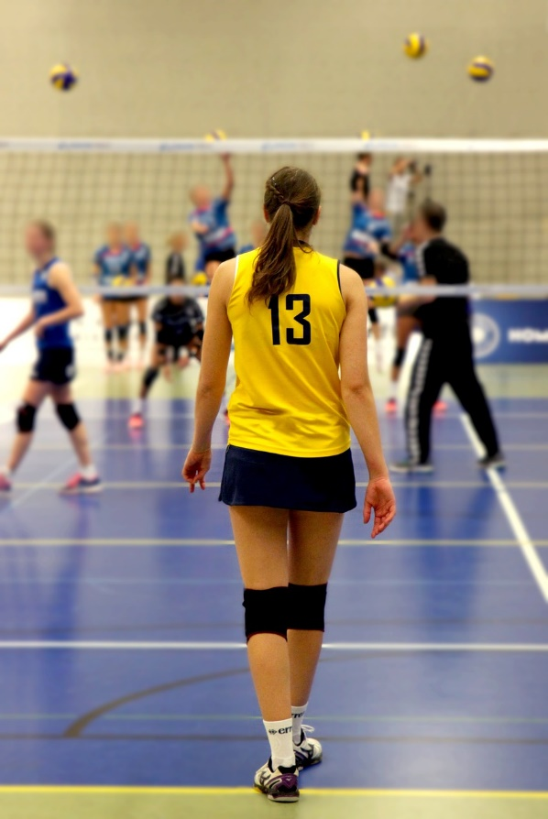
SPORT
The Padova University Sports Centre (CUS) offers many
opportunities to take part in sports, competitive and amateur alike,
at the two structures located in Via Giordano Bruno and
Via Jacopo Corrado.
In addition to services for payment, there are "no pay" activities for which the Centre makes its facilities available free of charge to users during set time slots, typically the track and field arena, 5-aside football pitch, and tennis, volleyball, basketball and handball courts
http://www.cuspadova.it/
https://www.unipd.it/en/sport

Slide 40




UNIPD APPS
Make the best out of your "remote" student life using these apps:
MyUniPD
The new official app of the University of Padova that allows you to easily manage your academic career on your smartphone or tablet.
OrariUniPD
This app allows students to view and manage lectures and exam session timetables as well as registering lecture and classroom attendance, and check study space availability at any time.
CAREER SERVICE UNIPD
This is the app of the University of Padova dedicated to the search for jobs and internships both in Italy and abroad
AFFLUENCES
The Affluences app allows students to check study space availability at any University library in real-time and book a place to study.

Slide 41
DEPARTMENTAL SERVICES

Slide 42


DEPARTMENTAL OFFICES
International Desk
Orientation/advising for degree programme choice
Admissions & enrolment
Students' welcome
Support through your academic career
Assistance in teaching and learning integration
Encourage and facilitate access to University services and opportunities
Animal Care → cdl.animalcare@unipd.it

Slide 43

TUTORING OFFICE
TUTORING PROGRAMME:
  WHO?
  A senior student in your department
  WHAT?
  Support students throughout their
  University career:
    Time management
    Organisational difficulties
    Study plan
  HOW?
  Online (email/zoom) & in presence helpdesk: tutor.agrariamedicinaveterinaria@unipd.it
  Timetable and contact at: https://www.agrariamedicinaveterinaria.unipd.it/scuola/contatti/tutorato

Slide 44



DEPARTMENTAL OFFICES
School Office
agraria.medicinaveterinaria@unipd.it
Career Service Office
silvia.begni@unipd.it
stage@unipd.it
Projects and Mobility Office - Agripolis Campus
erasmus.agripolis@unipd.it
School of Agricultural Sciences and Veterinary Medicine Website
https://www.agrariamedicinaveterinaria.unipd.it/en/

Slide 45
LIVING THE CAMPUS & THE CITY

Slide 46
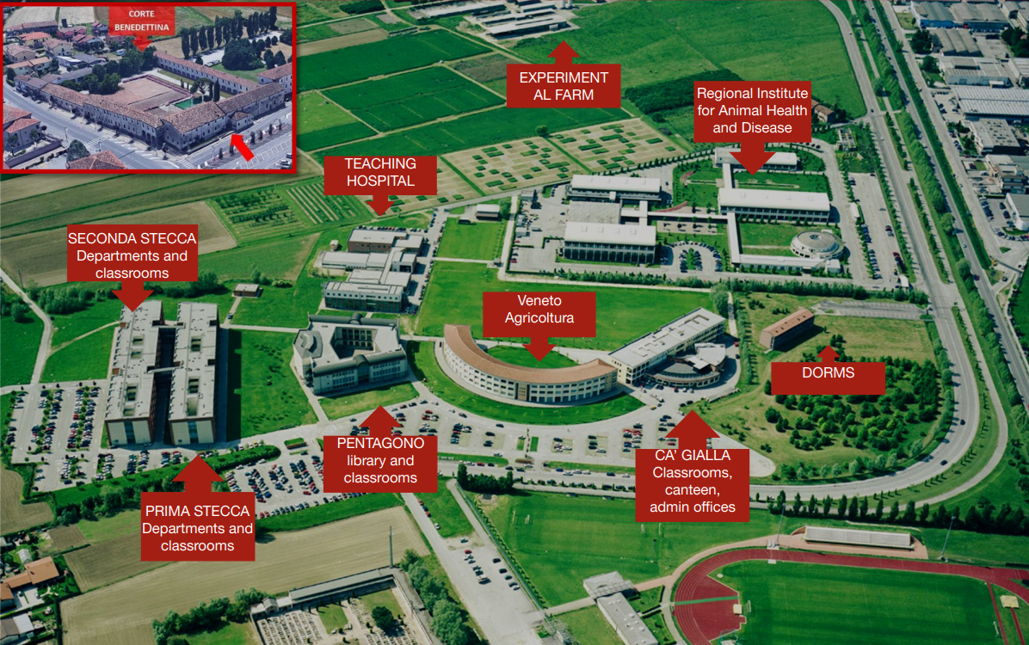
CAMPUS
AGRIPOLIS CAMPUS Viale dell’Università n. 16 – 35020 Legnaro – Agripolis - Padova

Slide 47
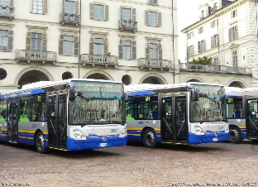
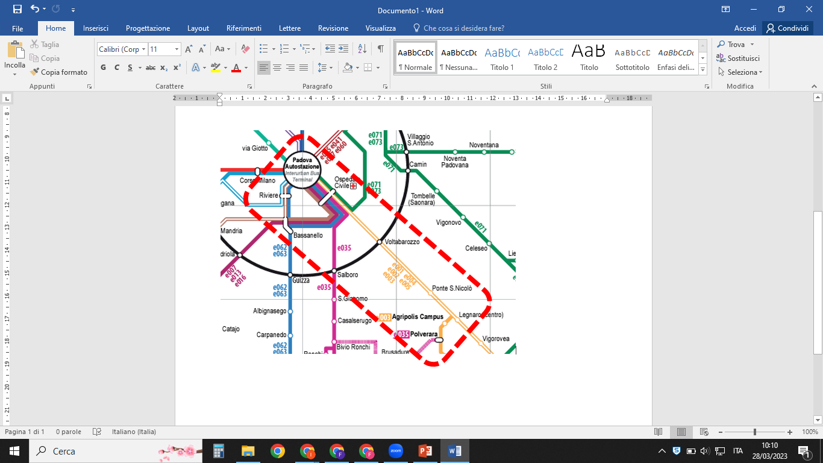
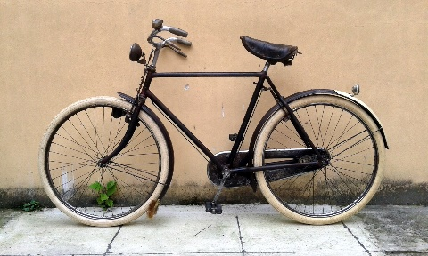
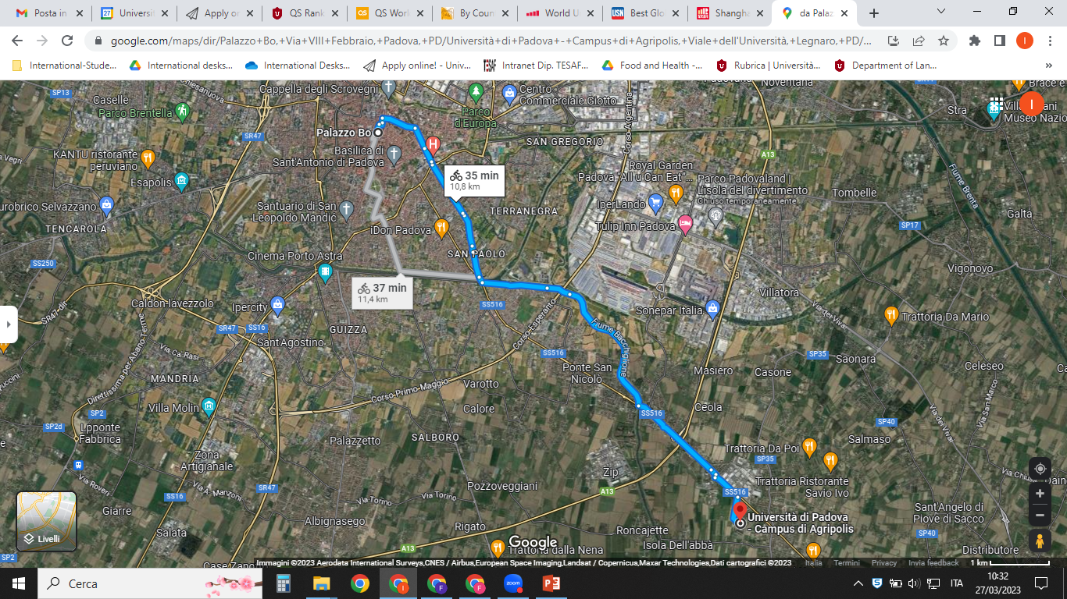
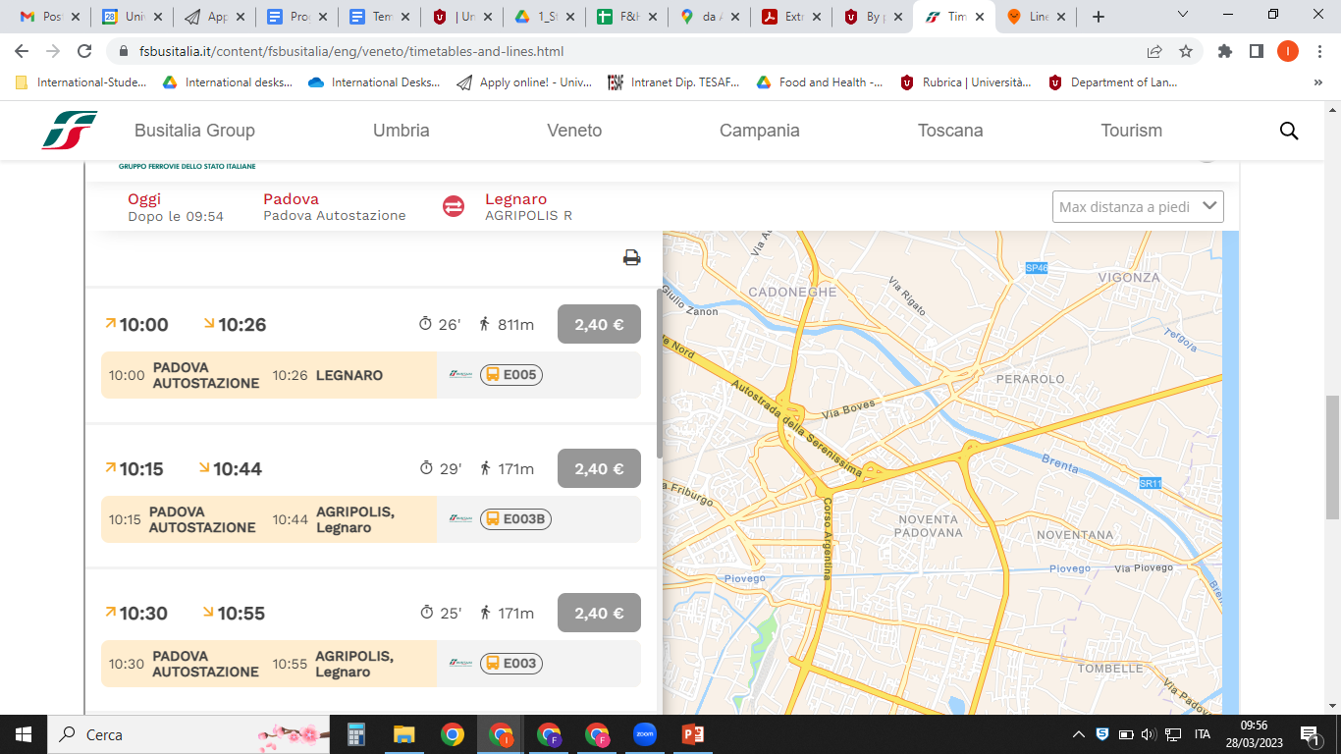
About 35 mins
by bike
from Padova City Center
Bus Lines e003/e005
(every 15 mins from Padova
Bus Station)

Slide 48






GETTING AROUND IN THE CITY
The University promotes various initiatives in order to improve sustainable transport in urban areas.
City buses and tram: Tickets can be bought at edicole (newsagents), tabaccherie (tobacconists) as well as online (app DropTicket); Information on bus lines are available at APS offices and online (app Busitalia Veneto). A special free transport for people with disabilities can be booked by phone: 049 7355147
An on-call night time bus service, founded in collaboration between the University, the Municipality of Padova and Busitalia Veneto, is also available, upon request via the Night Bus App (QuiBus).
There are many Bike and Scooter sharing options in Padova that can be used through their apps (Ridemovi, Weelo, Dott, Bit)
Notes:
‹#›
Elisabetta

Slide 49
GETTING AROUND
Padua can be reached easily by the most common transportation routes and provides a network of public services and various other means in order to get around.
For more information on:
Bicycle and scooter
Bus, coach, tram, train
Taxi and car
you can visit: https://www.unipd.it/en/getting-around-padua

Slide 50
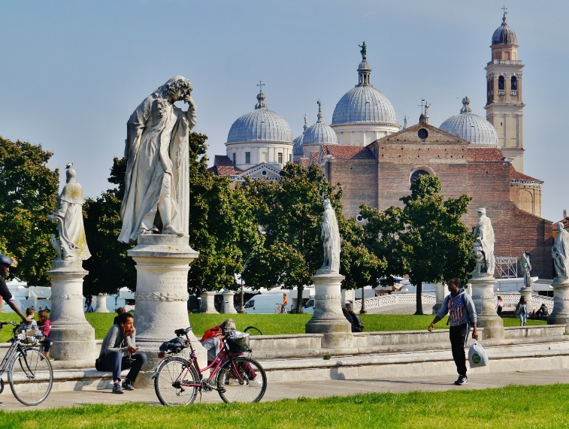
DISCOVERING PADUA
A city definable as truly student-friendly, Padua (Padova) hosts almost 70,000 students within a population of little more than 210,000 inhabitants: these are the numbers depicting one of the oldest university towns, where student and city life coexist in close proximity on a daily basis.
Prato della Valle, St. Anthony Basilica, Scrovegni Chapel are only the most renowned examples of all the Cultural landmarks you can visit in Padova!
Many artistic and monumental masterpieces are part of the University cultural heritage, including Palazzo Bo, Palazzo Liviano, the Botanical Garden and La Specola.
There are plenty of opportunity in town to listen to good music and take part in cultural activities, like visiting city museums and exhibitions or going to theatres, concert halls and cinemas: Music, theatre and cinema
Please check here the University of Padova programme of Events.

Slide 51

CONTACTS
Enrolment procedures: international.admission@unipd.it
Residence permit: saos@unipd.it
Student career (after enrolment): carriere.studenti@unipd.it
Tuition fees, Regional scholarship: benefici.studenti@unipd.it
Isee/CAF CIA PADOVA: caf-iseeunipd@ciapadova.it
Accommodation: housing@unipd.it

Slide 52





cdl.animalcare@unipd.it Animal Care
BCA_campus_unipd bca_campus_unipd
bca_campus_unipd

Slide 53



universitypadova
International Relations Division
Global Engagement Office
@unipd

Slide 54
Università degli Studi di Padova

