Slide 1

Welcome to the ESEVT Evaluation Team
Evaluation of the DCVM, University of Padova
Legnaro, October 19-23, 2020

Slide 2
Degree Course of Veterinary Medicine (DCVM)
University of Padova
The Establishment and the Territory
Prof. Alessandro Zotti

Slide 3



Brief history of the Establishment
1773 – 1873 Collegium Zooiatricum Patavinum
Brief hisory of the Establishment
1992 – 2011 Faculty of Veterinary Medicine
Faculty of Veterinary Medicine
University of Padova
2012 - 2020 Degree Course of Veterinary Medicine

Slide 4

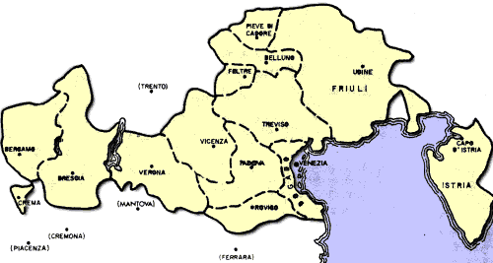
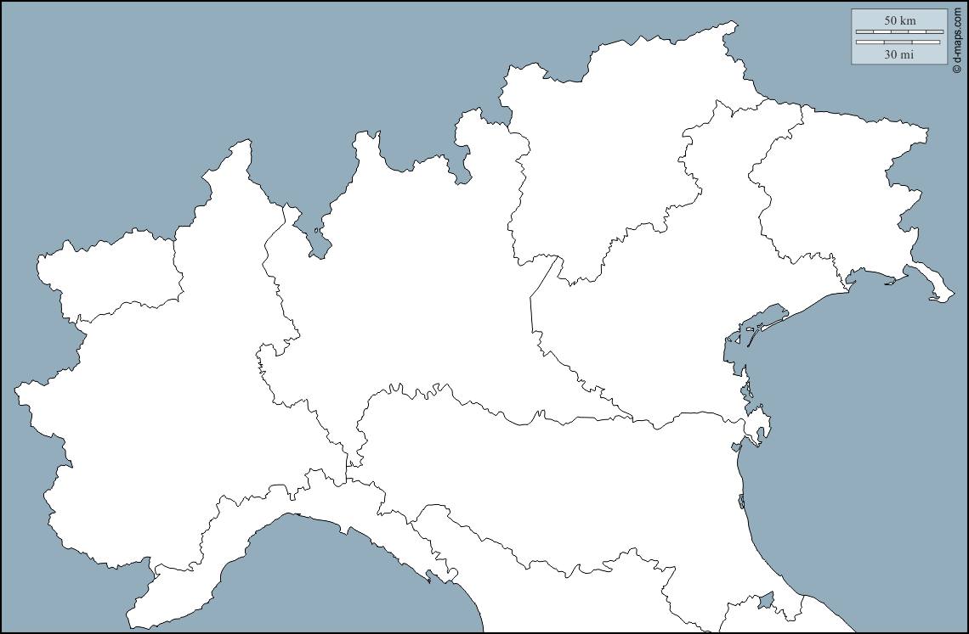
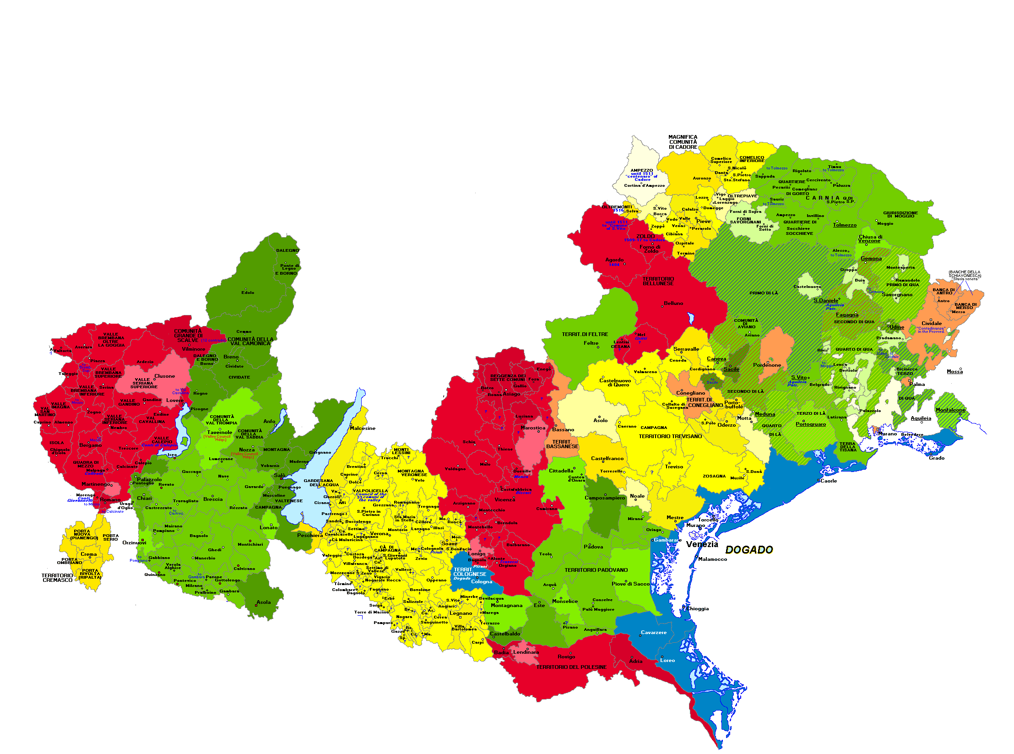
Territory Served by the Degree Course of Veterinary Medicine
Current regional subdivision of northern Italy
Territorial Extension of the Serenissima Republic

Slide 5
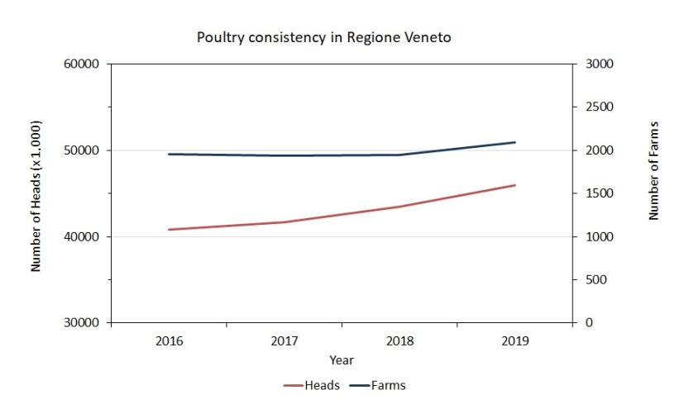
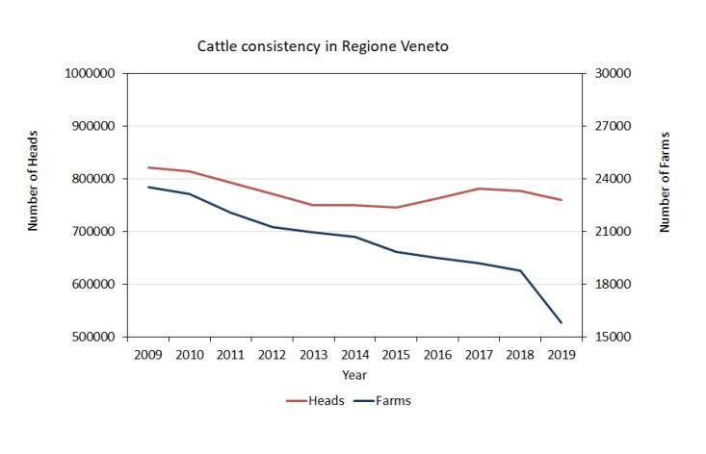
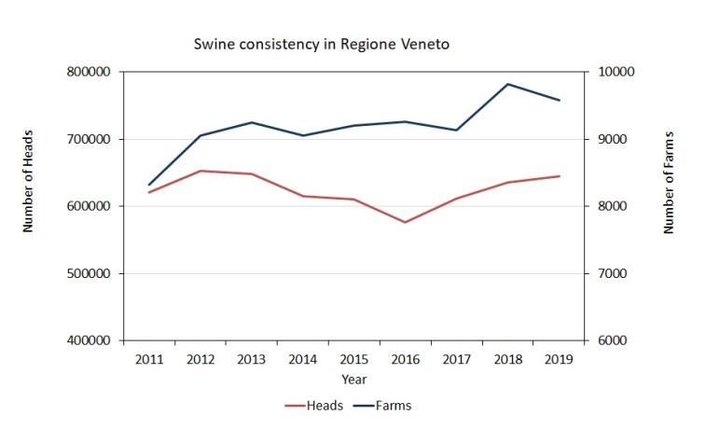
Bovine, Swine and Poultry consistencies of the Regione Veneto between 2011 and 2019

Slide 6
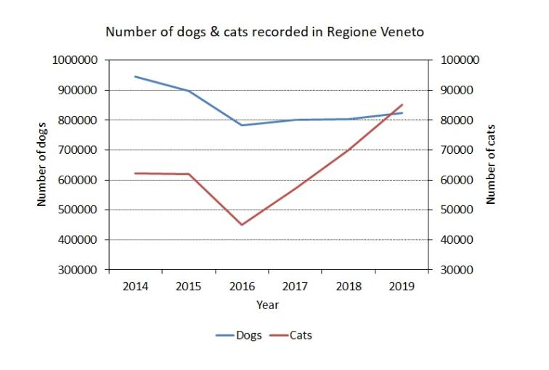
Pet (dogs & cats) population dynamics in the Regione Veneto between 2014 and 2019

Slide 7
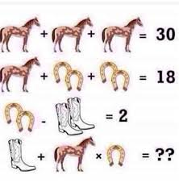

……and Horses?

Slide 8
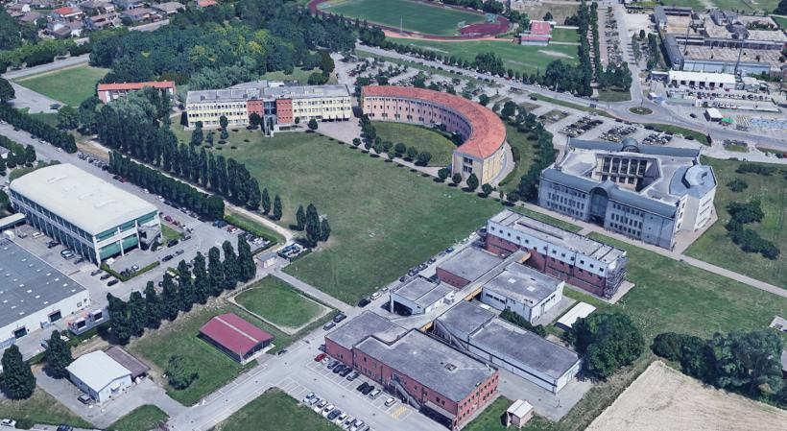
Agripolis Campus and the Establisment

Slide 9
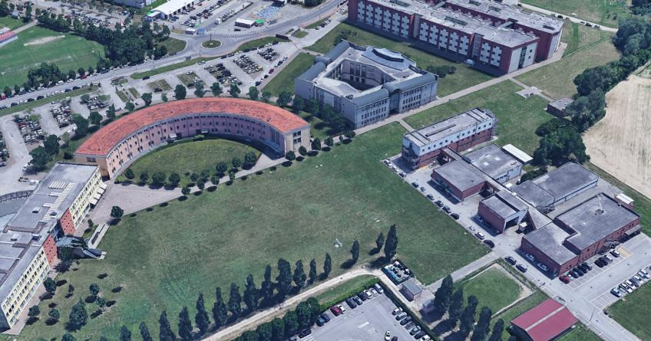
Agripolis Campus and the Establisment

Slide 10
Agripolis Campus and the Establisment

Slide 11
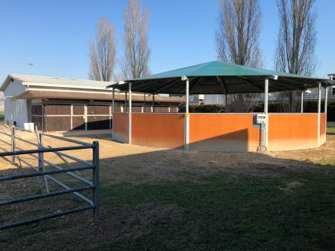
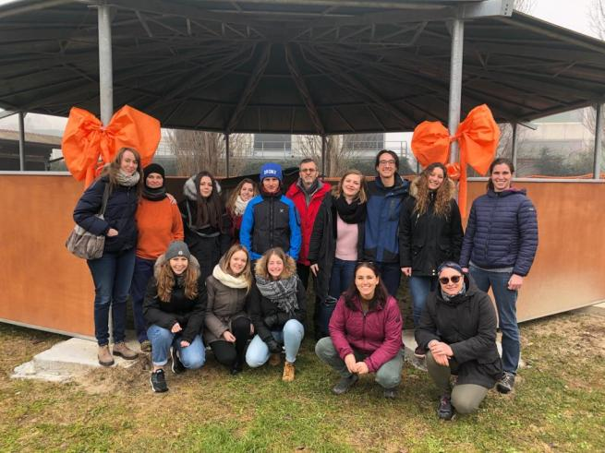
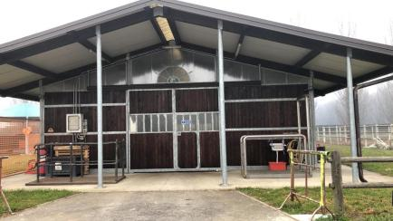
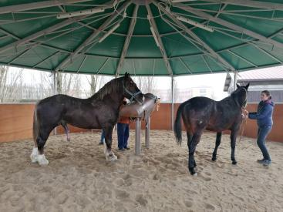
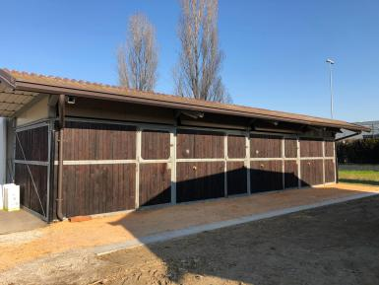
The Equine Breeding Center

Slide 12
Agripolis Campus and the Establisment

Slide 13
Degree Course of Veterinary Medicine (DCVM)
University of Padova
The Curriculum and its performances
Prof. Matteo Gianesella

Slide 14

Educational offer
DURATION = 5 years
EXAMS = 30
ECTS = 300
NATIONAL
  245 ECTS: frontal lessons and practical works
  8 ECTS: elective courses
  9 ECTS: Thesis dissertation
  3 ECTS: English test
  35 ECTS: practical training «Tirocinio» activities
PADUA
Notes:
14

Slide 15

DCVM PERFORMANCE DATA

Slide 16

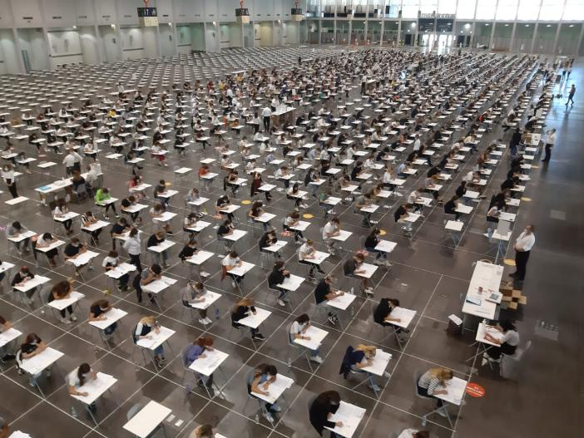
DCVM attractiveness
1 open position for about every 12 requests

Slide 17
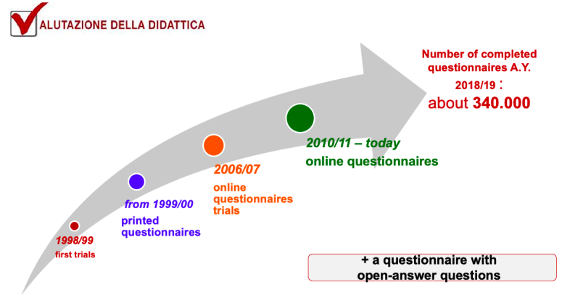
Evaluation of teaching
UNIPD ON-LINE QUESTIONNAIRE
Mandatory since
a.y. 2016/2017
Information on:
global satisfaction
organizational aspects
efficacy of the educational activity
coherent with contents and syllabus
preliminary knowledge
perceived workload

Slide 18
DCVM Teaching evaluation
UNIPD ON-LINE QUESTIONNAIRE
7.69
7.77
7.71
8.18
8.01
7.78
7.88
7.77
AVERAGE 7.9

Slide 19
Practical training «Tirocinio» evaluation
DCVM ON-LINE (BY MOODLE) QUESTIONNARE
7.83
7.80
7.81
AVERAGE 7.8

Slide 20
Time to Degree
7.9
8.0
7.9
7.9
8.0
7.8
NATIONAL AVERAGE 7.9
6.6
6.4
6.4
6.2
5.9
6.1
UNIPD AVERAGE 6.2

Slide 21

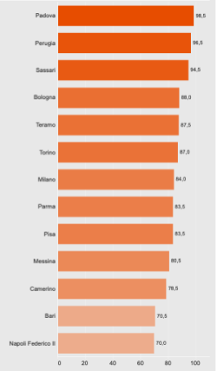
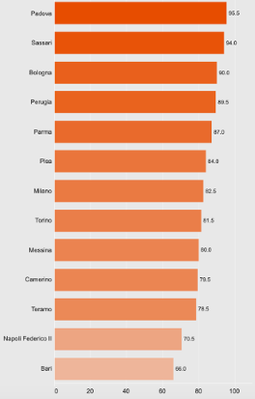
CENSIS DCVM Ranking
2019
2020
National ranking based on:
Student’s career progression
international relations

Slide 22


TEACHING ACHIEVEMENTS IMPLEMENTED BY THE DCVM OVER THE LAST FEW YEARS

Slide 23
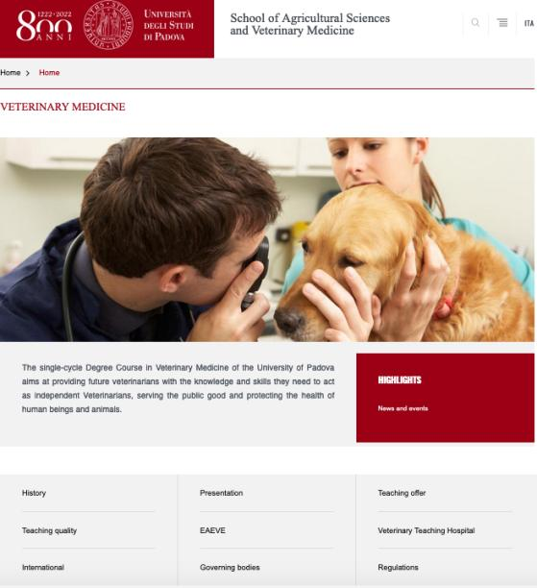
DCVM website

Slide 24
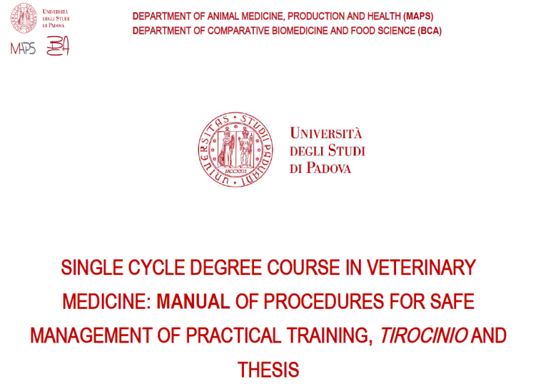
Standard operating procedures manual for safe and practical works, «Tirocinio» and Thesis
WORKS

Slide 25
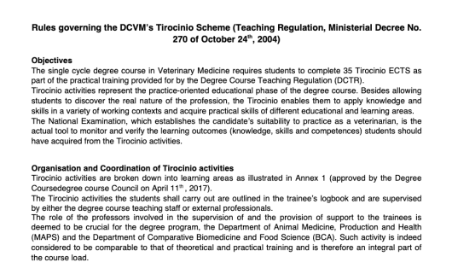
«Tirocinio» regulations
Rules concerning:
Objectives
Contents
Organisation and Coordination
Access requirements
Assessment procedures
Registration process of competencies

Slide 26
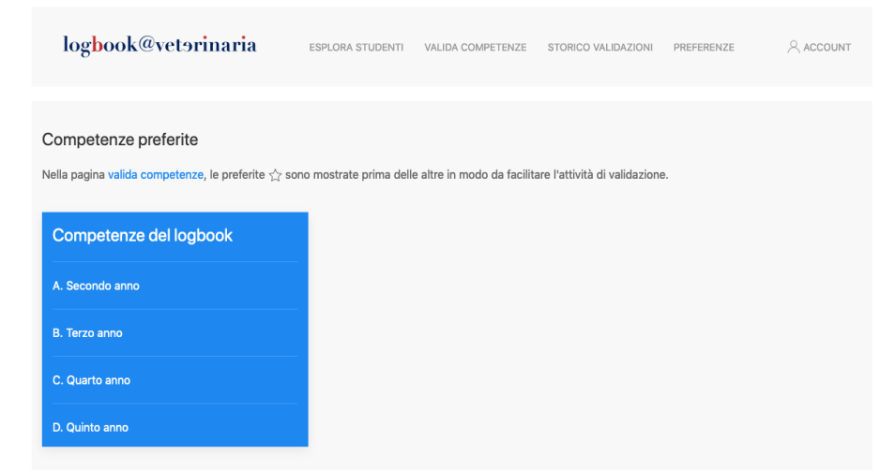
Registration process of competencies: electronic logbook

Slide 27
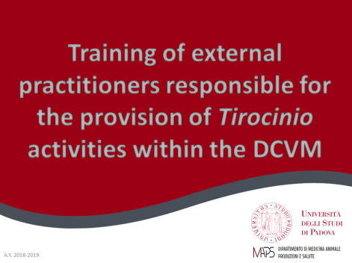
Training course for external practitioners involved in «Tirocinio» activities
Online training course in order:
  to introduce common teaching methods
  to share criteria for students evaluation
At the end of the course they must take an online test and pass it

Slide 28
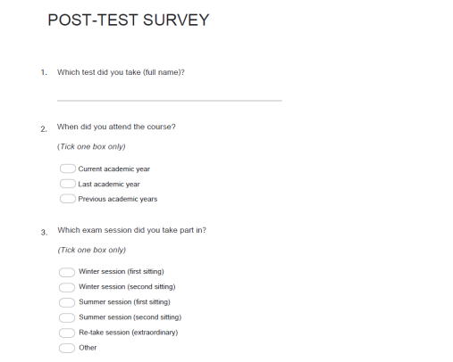
Questionnaire to assess the
evaluation procedures
The questions refer to:
study load
number of attempts
consistency with the syllabus
time needed to prepare exam
relevant teaching material

Slide 29


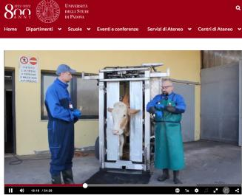
Turning COVID threats
into opportunities
NEW CHALLENGES:
Increased use of online tools (e-book, websites, etc.)
Implementation of already existing training courses on new teaching approaches (supervised teaching, problem-based learning, etc.)
Increased use of already existing teacher-student teaching aids (Moodle, mediaspace, etc.)

Slide 30
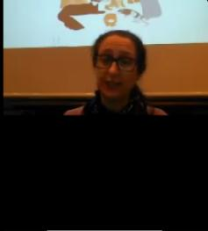
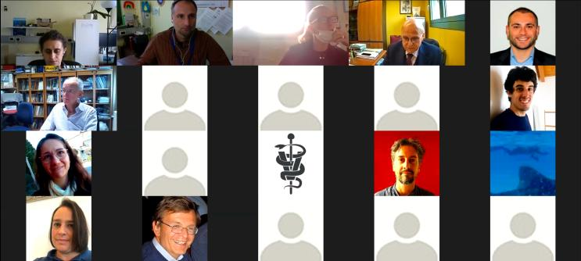

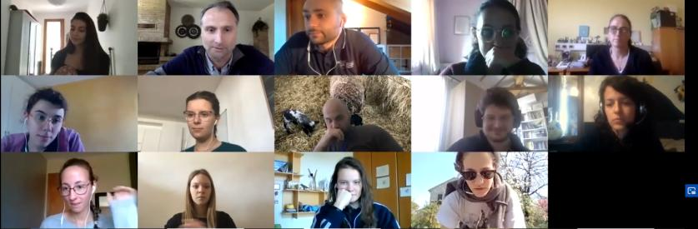
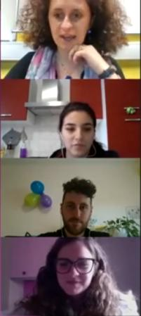
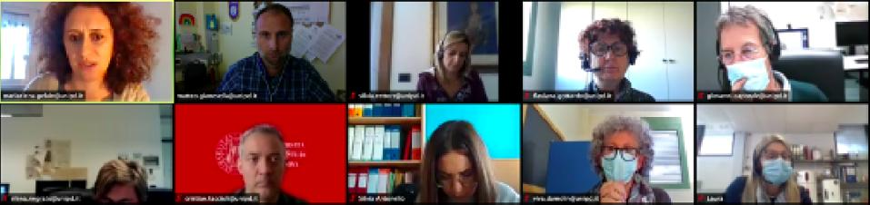

Slide 31
Thank you for your attention

